Slide 1
FYPJ
Exserlan
Realtime Data Visualisation
Programmed by
Amirul Faiz ( 170019C )
Gerald Chia ( )

Slide 2
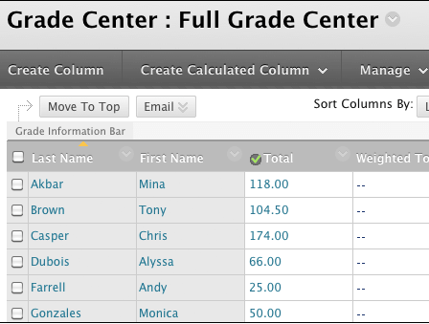
So outdated!
What does it all mean?
What if we dive deeper?

Slide 3
—Peter Sondergaard, Senior VP and Global Head of Research at Gartner, Inc.
“Information is the oil of the 21st century, and analytics is the combustion engine.”

Slide 4
01
02
Introduction
Understanding
03
04
The Leap
Conclusion
Project Scope and timeline
How it works and its’ benefits
The underlying architecture & Technology used
What’s it for the future?

Slide 5

01. The Great Leap into the abyss
You could enter a subtitle here if you need it

Slide 6
01. Introduction
“A journey of a thousand miles begins with a single step”

Slide 7
What is Exserlan?
The project is meant to create a real time learning analytics system to aid lecturers to gather instant insights into learners' progress

Slide 8

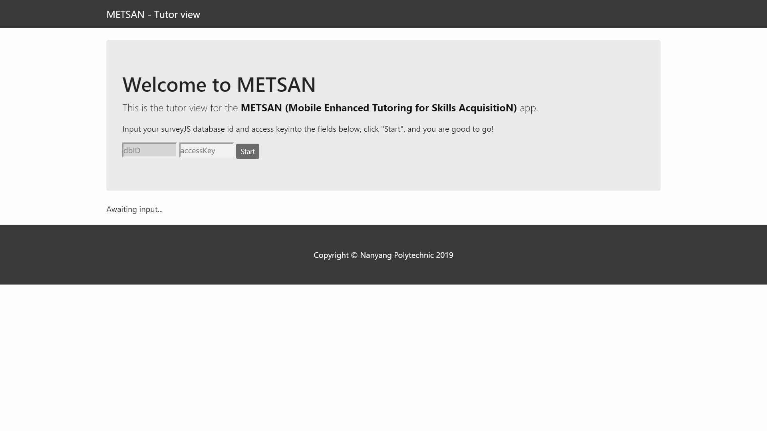
The Start

Slide 9
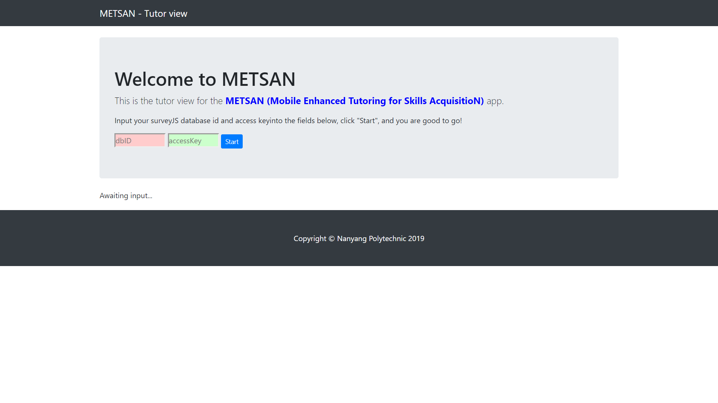
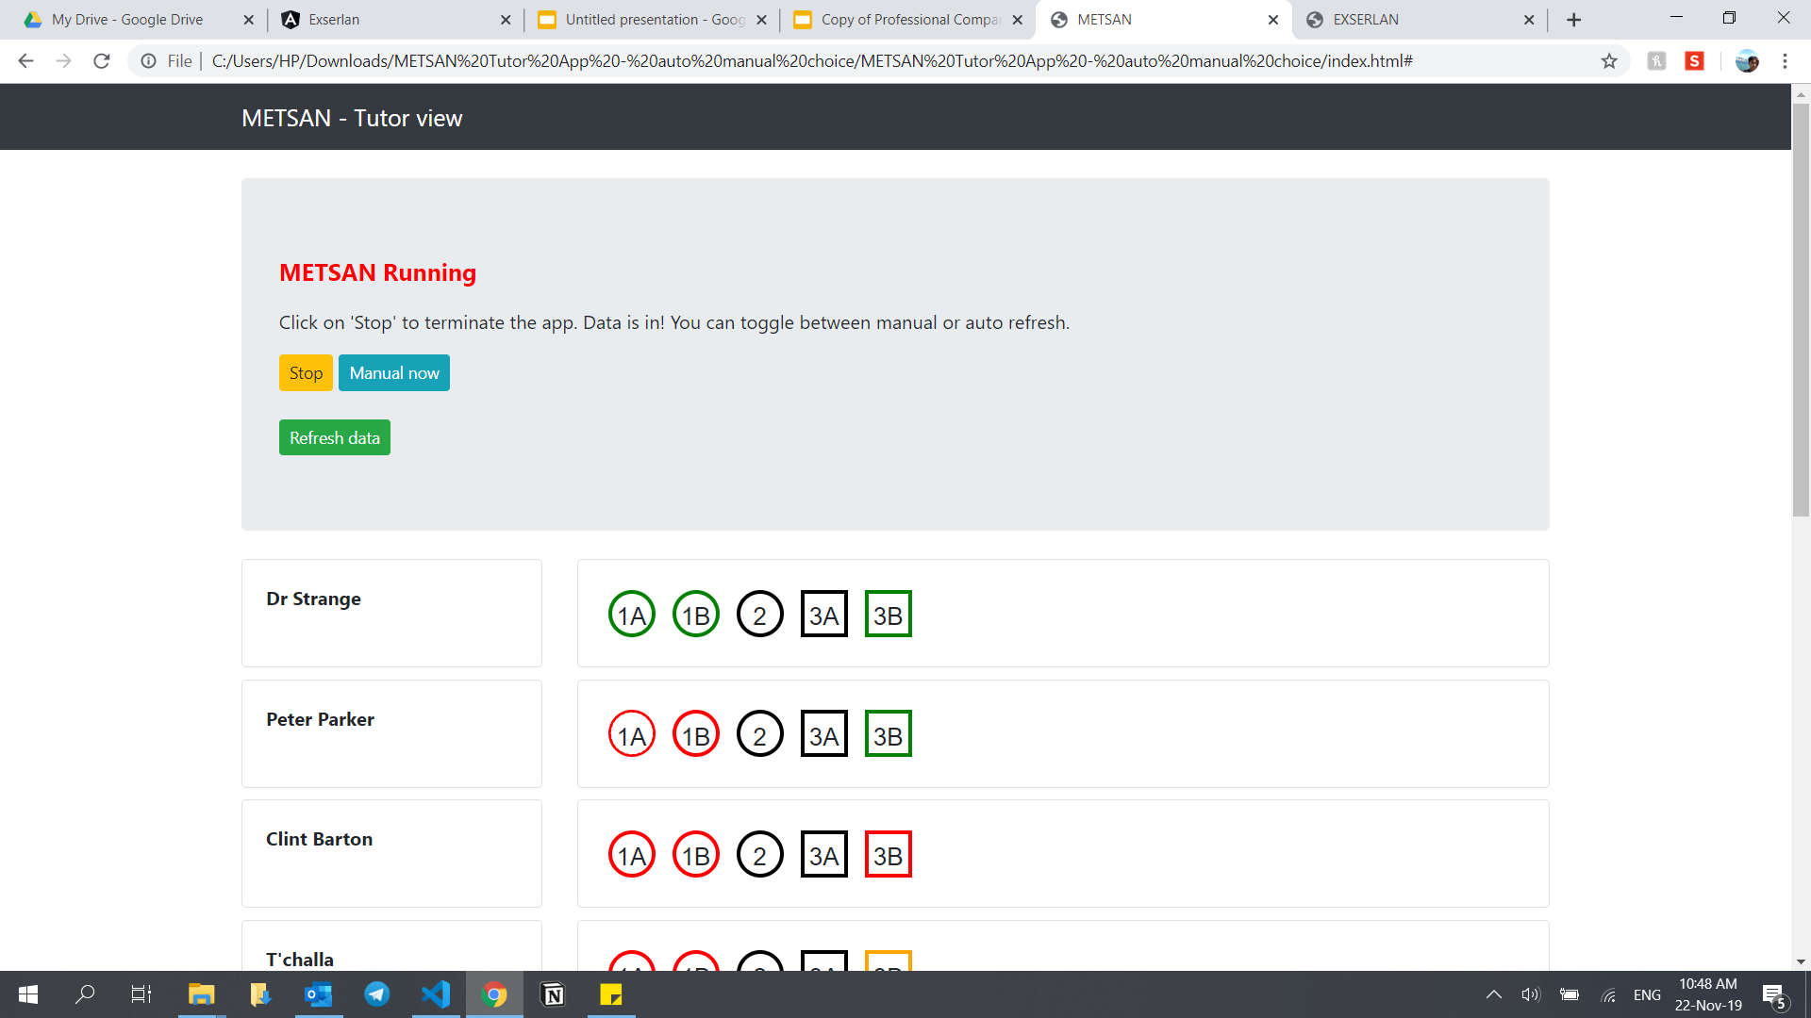
What’s Been Given?
Front Page
Data controller
Where Lecturer’s would input the Database ID and Access Key taken from SurveyJS
Controls the refreshes of data at a set rate requesting from SurveyJS

Slide 10
A lot of work to be done
Things to do:
Understand the underlying Data & Infrastructure
Create purposeful charts
Improve upon the design if possible
Visualisation
What does it all mean?

Slide 11
Timeline
Exserlan
Exserlan- Angular
The Start
Interim
Today
Not Drawn to Scale**

Slide 12





Architecture
ML
Lecturer
Student
POST
Exserlan

Slide 13
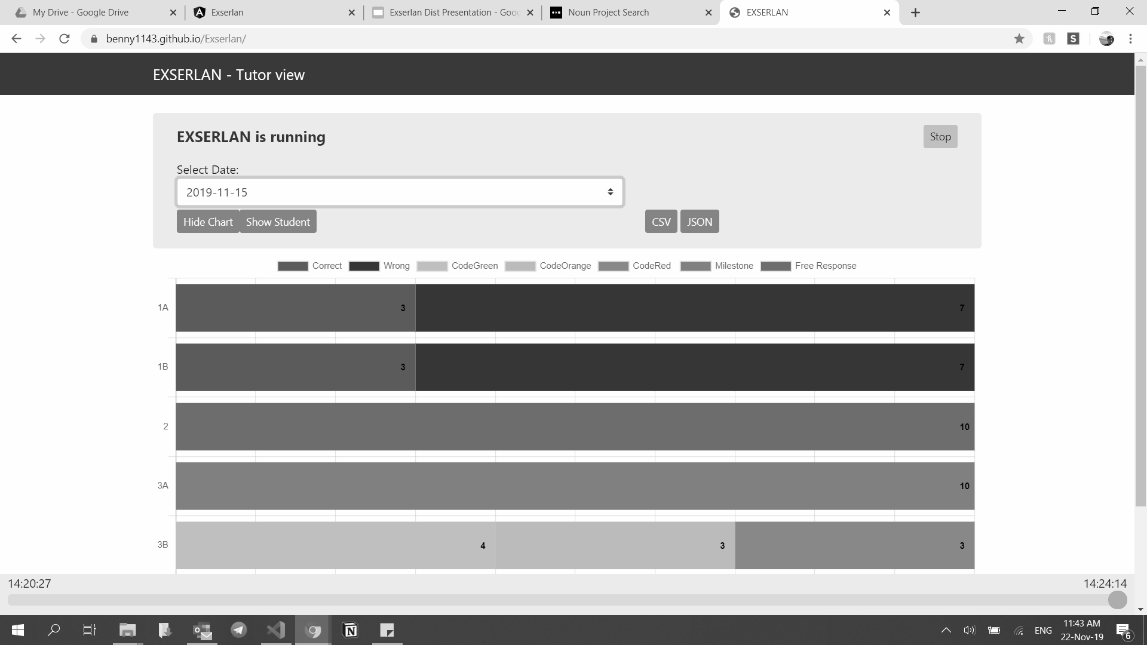
Exserlan
Understanding
Not Angular*

Slide 14
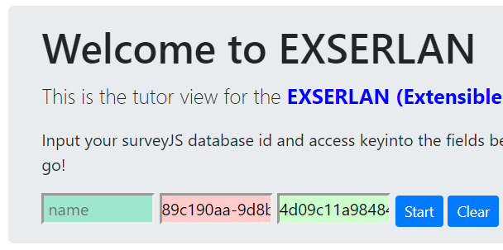
How it works: Prerequisite (Saving Course)
PostID
AccessID
Lecturer
Student
Lecturer to Create Account and a blank Survey in SurveyJS
Create a text file with the PostID given in the blank Survey and put it with the folder for the assessment
Enter the Access ID and Post ID give by SurveyJS into Exserlan
Exserlan

Slide 15
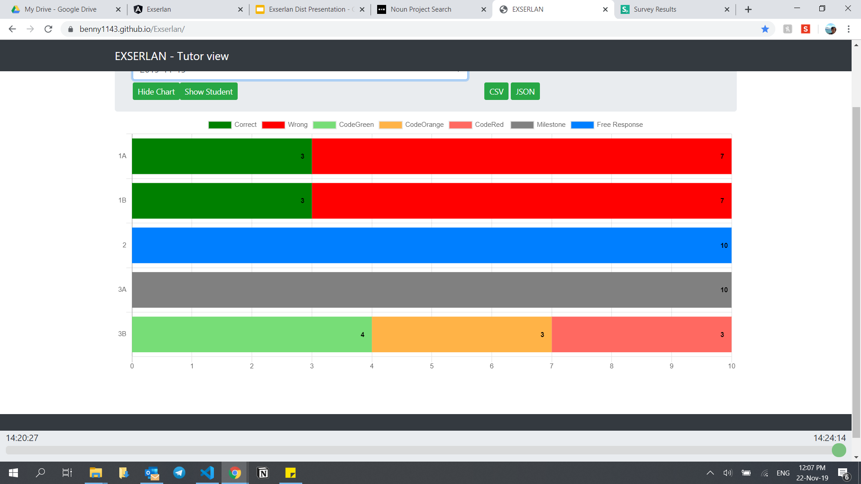
How it works
Student
Exserlan
Student Answers a Question
Data is being sent to SurveyJS
When the Lecturer opens Exserlan, it will get data from SurveyJS

Slide 16
How does it benefits me as a lecturer?
Realtime
Data Visualisation
Enables lecturers to approach students who have answered the questions wrongly on the spot, rather than after the assessment
Aids lecturers to understand which questions are more prone to getting wrong and improve upon how the lecture is being taught

Slide 17
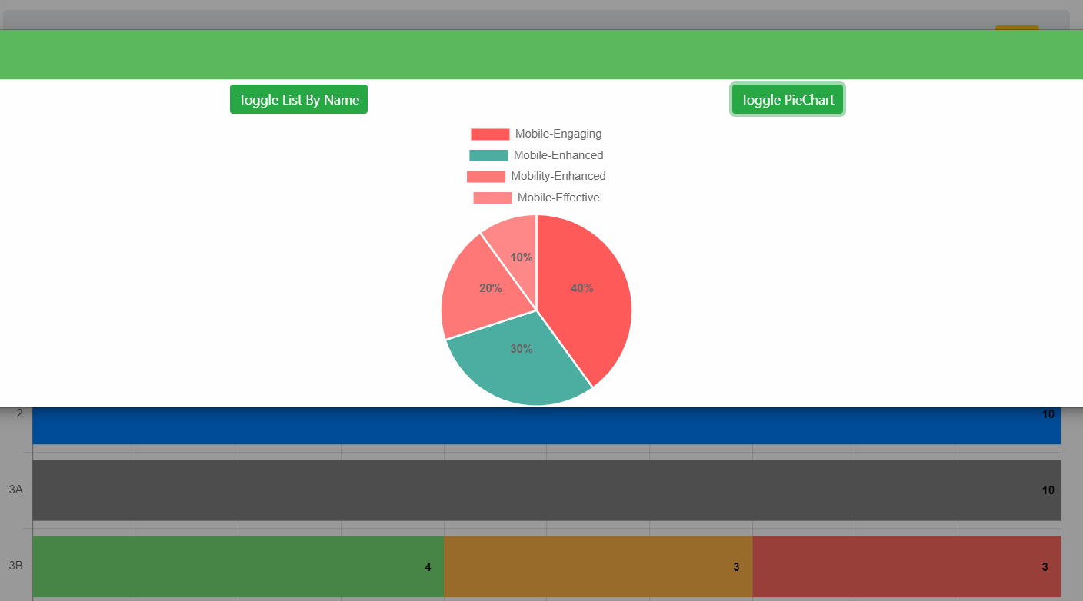
What’s included
Bar Chart
Pie Chart

Slide 18
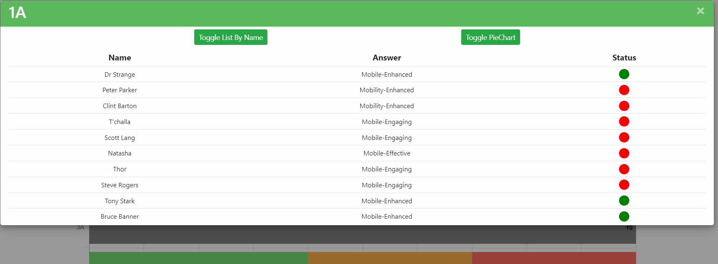
Resolve Status

Slide 19
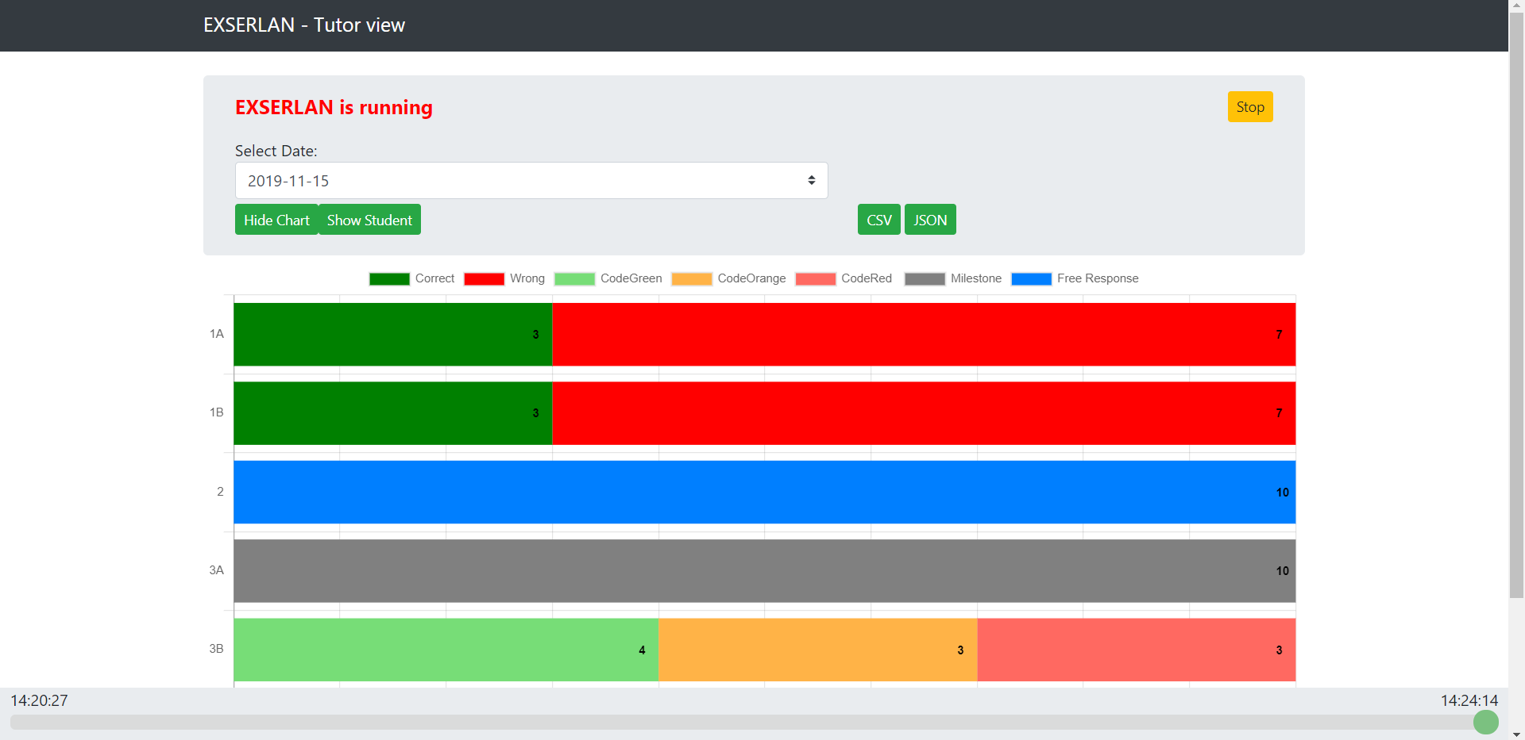
The Time Machine
Inspired by Mac

Slide 20
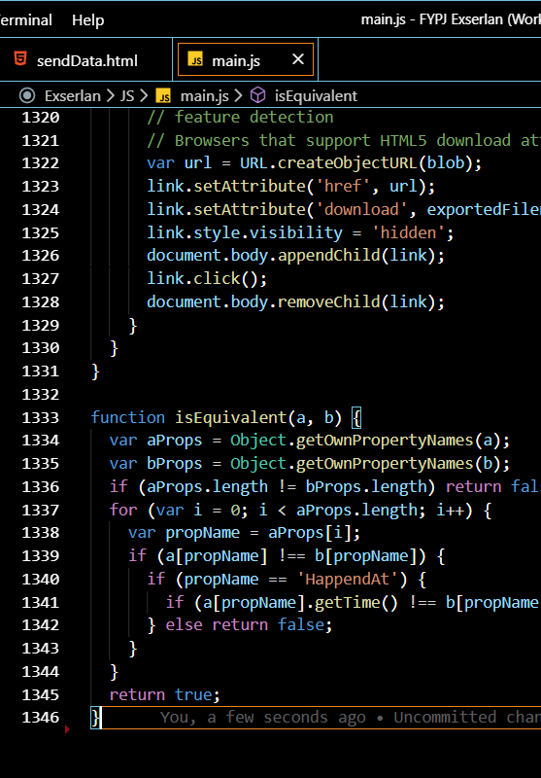
Difficulties Face
State Management with various components updating as data comes in
Long JS Code, hard to maintain as more codes are added
Working with just Pure JS CSS and HTML with the aid of ChartJS to provide the charts
😱

Slide 21
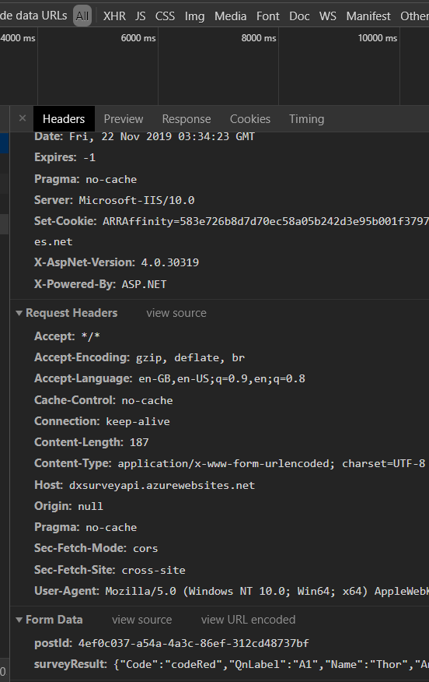
Scary Fact
That I found out
API Post ID is exposed
Recreation of AJAX post is possible from anywhere

Slide 22

02. The Leap
Exserlan-Angular
“After much persuasion”

Slide 23



Tackling Various Issues
Security Design
Web Design
Code Design

Slide 24



Solution Architecture
Student
Exserlan
Security Design

Slide 25

Solution Architecture
Testing Tool
Recommend before deployment
What it is?
Running using Express js API
How it benefits?
Checks if Assessment is valid
Additional Configuration on Access-Control-Allow-Origin to only allow post data from Blackboard hosted assessments
Security Design

Slide 26
Solution Architecture
What it is?
NoSQL Cloud Database
How it benefits?
Realtime functions using Angularfire
Allow Rules to prevent access to data belonging to other users
Security Design

Slide 27
User Journey
Previously
Create account and a blank Survey in SurveyJS
Create a text file with the PostID given in the blank Survey and put it with the folder for the assessment
Get the Access ID from another website
Enter the Access ID and Post ID give by SurveyJS into Exserlan
Now
Create account
Create course
Download key with a click of a button and put inside the folder
Web Design

Slide 28
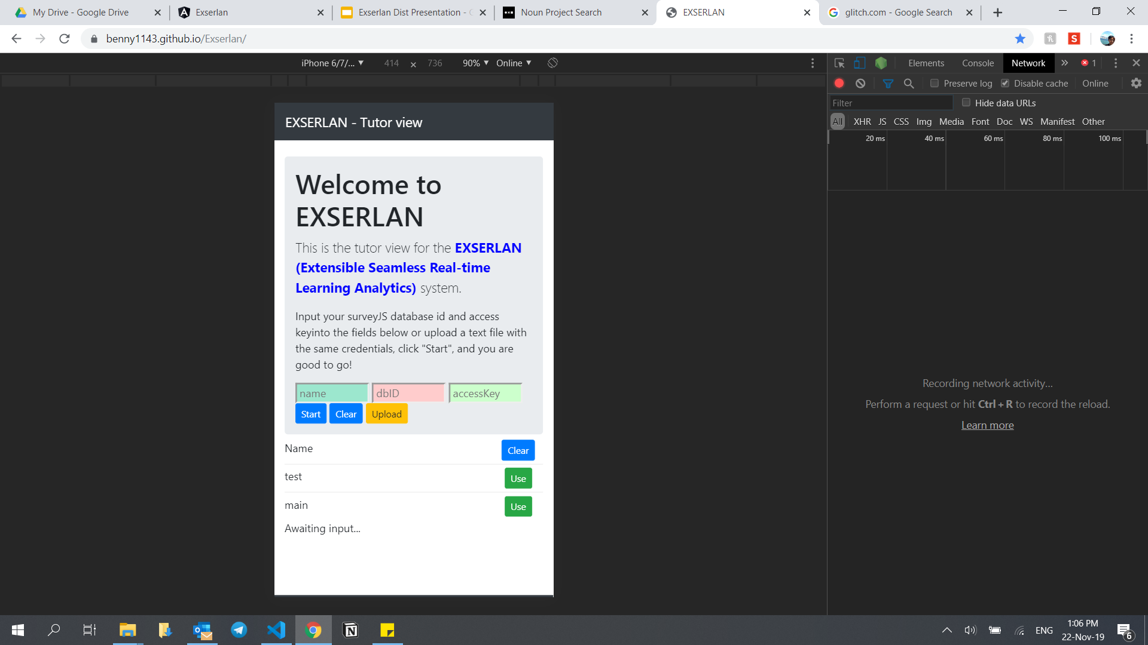
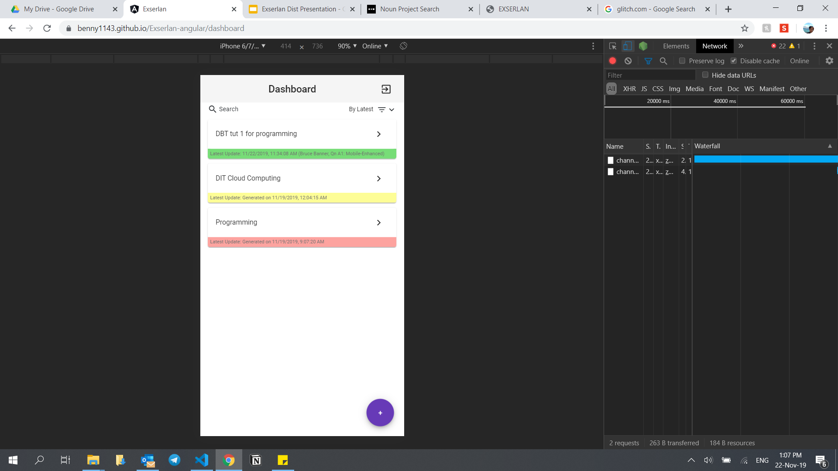
Design
Previously
Now
Web Design

Slide 29

Design Tech
Leveraging on Angular Material for Design
Web Design

Slide 30
Dashboard Design
See the latest update in a glance
Assessment Control
Update & Delete
Download Key
Create Assessment
Search Assessment
+ Color indicators
Web Design

Slide 31
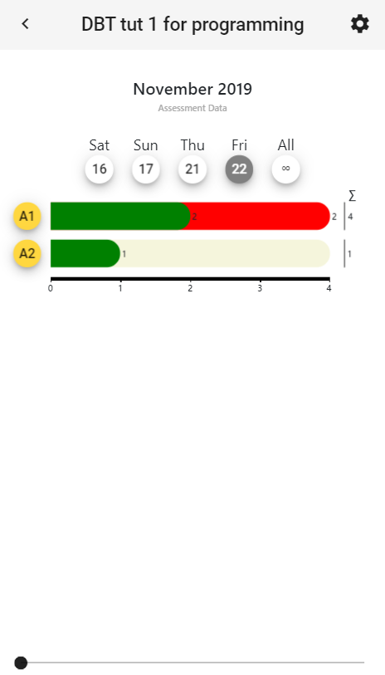
Data Visualisation
New
Custom Made Bar Chart for future customization
Better design, using Whitespace
Same as Previous
Resolve status
Pie chart
Time Machine
Web Design

Slide 32
Angular & Typescript
Angular
Reactivity through data binding
Ables the creation isolated components
Reusability
Typescript
Code scalability with “Interface oriented development”
Code Design

Slide 33
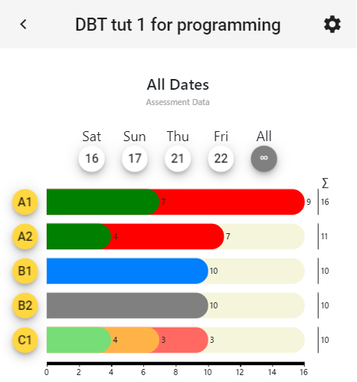
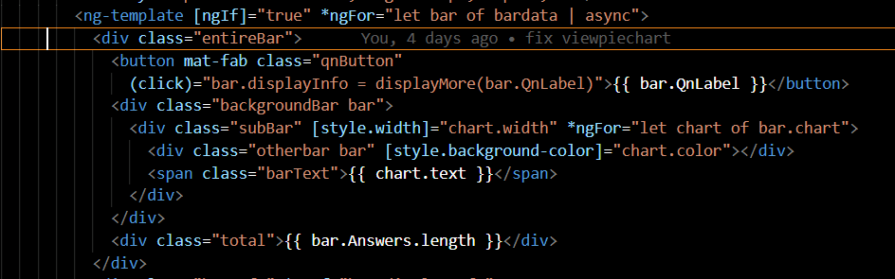
Code Design

Slide 34

4. Conclusion

Slide 35


ADAPT LEARNING

Slide 36
What is Adapt Learning ?
E-learning authoring tool that creates fully responsive
Adapt is a free and easy to use
Supports HTML 5 E-Learning
Supports any devices

Slide 37
What is Adapt Authoring Tool?
Create responsive e-learning courses without programming knowledge
Allows you to quickly build content using the Adapt Framework

Slide 38
What is Adapt Framework Tool?
An extensible HTML5 e-learning framework for developers.
creates HTML5 e-learning courses
delivered with a web server or a with SCORM compliant learning management system

Slide 39

Challenges

Slide 40
SOLUTION

Slide 41
COMMUNITY

Slide 43
Q&A ? Q&A : Thanks!

